Slide 1


Slide 2

Notes:
The American Physical Therapy Association (APTA) and the Academy of Pediatric Physical Therapy (APPT) support students and new professionals as they embark on their professional careers.

Slide 3

Notes:
Here’s how APTA and APPT can help.

Slide 4
Join. Develop. Engage. Transform.
APTA is nearing 100,000 members—be part of this special moment in our profession’s history!
Notes:
APTA is nearing 100,000 members and APPT is nearing 6,000 members, and we want physical therapists, physical therapist assistants, and students of physical therapy to be part of this special moment in our profession’s history!

Slide 5
Why Join or Stay an APTA Member Now and After You Graduate?
Notes:
If you’re graduating this year, first, congratulations! Second, you’ll have many choices to make as you get your PT license and begin your professional career.
Even if you still have 2 or 3 years of school ahead of you, consider the advantages you’ll have by keeping your APTA membership now and once you’re finished school – and you can augment your APTA membership by joining any or all of the 18 specialty sections, including the Academy of Pediatric Physical Therapy!
What are those advantages? There isn’t time here to list 100,000, or even 100. But here are 10 great reasons you and your association need each other.

Slide 6
10 Great Reasons to be an APTA Member
Career-Starter Dues

Slide 7
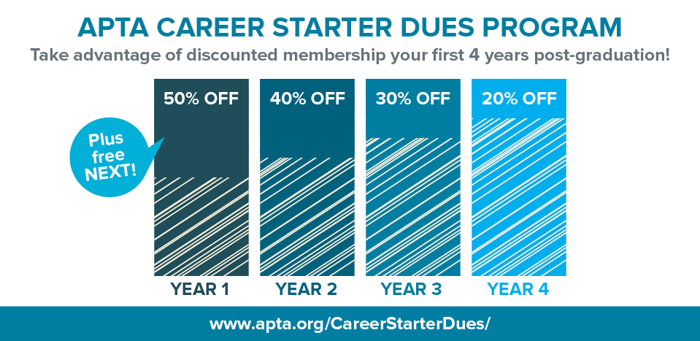
Notes:
Maintain your membership after graduation, and get 50% off your first year renewal postgraduation, with additional discounts over the following 3 years. Plus, get free registration to NEXT Conference & Exposition the your first year postgraduation upon membership renewal.
Career Starter Dues discounts apply to your Academy of Pediatric Physical Therapy dues as well!

Slide 8
Academy of Pediatric Physical Therapy Benefits
Notes:
The APPT Students/New Professionals (SNaP) Subcommittee is very involved in the Academy and is always looking for new members – get involved or just join them for mixers at our meetings!
The APPT Mentoring Program provides new graduates with a contact to assist with networking, professional development, and involvement in APPT. Mentors and mentees are paired based on clinical areas of interest and geography.
Professional support in the area of pediatrics through the quarterly Pediatric Physical Therapy and podcast, monthly electronic newsletters, fact sheets on an ever-growing number of topics, and seven special interest groups to provide additional specialized support for pediatric practice areas that you’re interested in.
APPT understands that students and new professionals are often strapped for cash, making it difficult to attend national meetings. To assist with costs, APPT sponsors the APPTAC Attendance Scholarship for Student/New Professional (to attend the Academy of Pediatric Physical Therapy Annual Conference) and the CSM Attendance Scholarship for Student/New Professional (to attend APTA’s Combined Sections Meeting).
APPT sponsors numerous continuing education opportunities throughout the year. This year, APPTAC will again offer a session titled “APPT Boot Camp for Students and Young Professionals: Preparing for a Career in Pediatric Therapy” to provide a variety of information specific to career development for those of you who are just beginning your physical therapy journey. APPT also offers a number of online APPT courses and journal clubs.
Interested in becoming a Pediatric Certified Specialist (PCS)? APPT has a number of resources that might help.
Join us on any or all of the following social media sites: Twitter, Facebook, Pinterest, and Linked In – sign up at www.pediatricapta.org under Resources/Social Media. For more information on APPT benefits, visit www.pediatricapta.org and click on Join Us/Benefits of Belonging!
For more detail on all of these benefits and more, visit www.pediatricapta.org under Join Us!

Slide 9
Rehabilitation Reference Center and ArticleSearch
Notes:
Your university library and online access to research is likely indispensable to you as you pursue your degree. But what happens after graduation, and you no longer receive those student-only perks?
The Rehabilitation Reference Center provides information on diseases and conditions, and has numerous point-of-care resources, including a collection of exercise images that alone would cost an individual $2000 to purchase.
ArticleSearch provides members easy access to journals and other resources relevant to clinical practice, including full-text access to research and articles from more than 4,500 clinical and academic publications.
Both resources are part of PTNow, APTA’s practice portal for members only.

Slide 10
Free access to APTA’s and APPT’s periodicals
Physical Therapy (PTJ)
PT in Motion
Pediatric Physical Therapy
APPT E-News
Notes:
APTA’s signature publications are free to members. You have full access to PTJ online, including archived issues. PT in Motion magazine is mailed to members 11 times a year.
APPT’s Pediatric Physical Therapy (with affiliated podcast and journal group) come out quarterly. APPT also keeps you up to date with what’s happening in the Academy with our monthly electronic newsletter.

Slide 11
APTA’s Red Hot Jobs
Notes:
Only APTA members can post resumes online and sign up for job alerts on the association’s Red Hot Jobs job bank and career center.
APPT also has a career center with resume help for pediatric-specific jobs.

Slide 12
Savings on specialist certification application and exam fees
Notes:
Many DPT graduates immediately want to pursue board certification in a clinical specialty. Members save 45% on the application and exam fees in any of the 9 specialties.
APPT provides support materials and course discounts for preparation from the Pediatric Certified Specialist exam!

Slide 13
Discounts!
Notes:
Save on office supplies, UPS shipping, online shopping, hotel stays, car rentals, and, of course, APTA offerings such as CEU courses, conferences (you’ll need to start acquiring CEUs sooner than you think!) and publications.
APPT members receive discounted rates on conferences, online courses, Academy “swag” and more!

Slide 14
You can keep up the camaraderie
Notes:
School is a collaborative, group environment. Continued APTA membership as a PT lets you enjoy the benefits of belonging to a community of like-minded professionals who will advocate with you on issues affecting your future.
As an APPT member, you’ll have access to pediatric physical therapy advice from leadership, special interest groups, and through online discussion groups, as well as opportunities to meet up at social events at conferences.

Slide 15
NEW! Financial management resources, including STUDENT LOAN REFINANCING
Notes:
APTA is looking out for its student members—the future of the physical therapy profession. We’ve just introduced 2 programs under a new Financial Management Resources area of APTA.org. First, members can apply for student loan refinancing. Second, members can access an online financial management tool for long-term help in keeping your finances in check. Find it at apta.org/FinancialSolutions/.

Slide 16
Every PT, PTA, and student makes a difference, and the more members we represent, the more clout we have
Notes:
APTA needs every PT and PTA to help advance its message about the power of physical therapy to transform society. When we approach Congress or the Centers for Medicare and Medicaid Services, doesn’t it have a nice ring to say we represent more than 100,000 members? That shows clout.
APPT represents children, adolescents, and adults with developmental disabilities and their families to APTA and to external organizations.

Slide 17

www.apta.org/join
Notes:
To join APTA and APPT, or renew your membership, go to www.apta.org/join.
Thank you!

Slide 18

Notes:
#APTA100K

